Slide 1
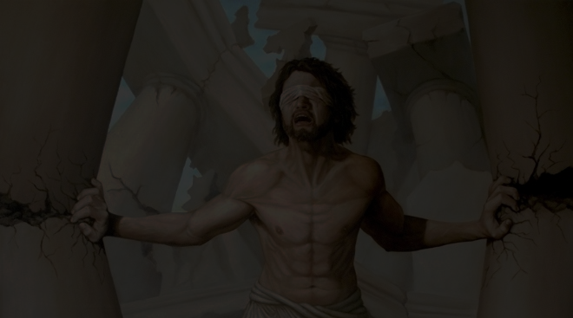
The Book of Judges
Broken People ~ Faithful God

Slide 2
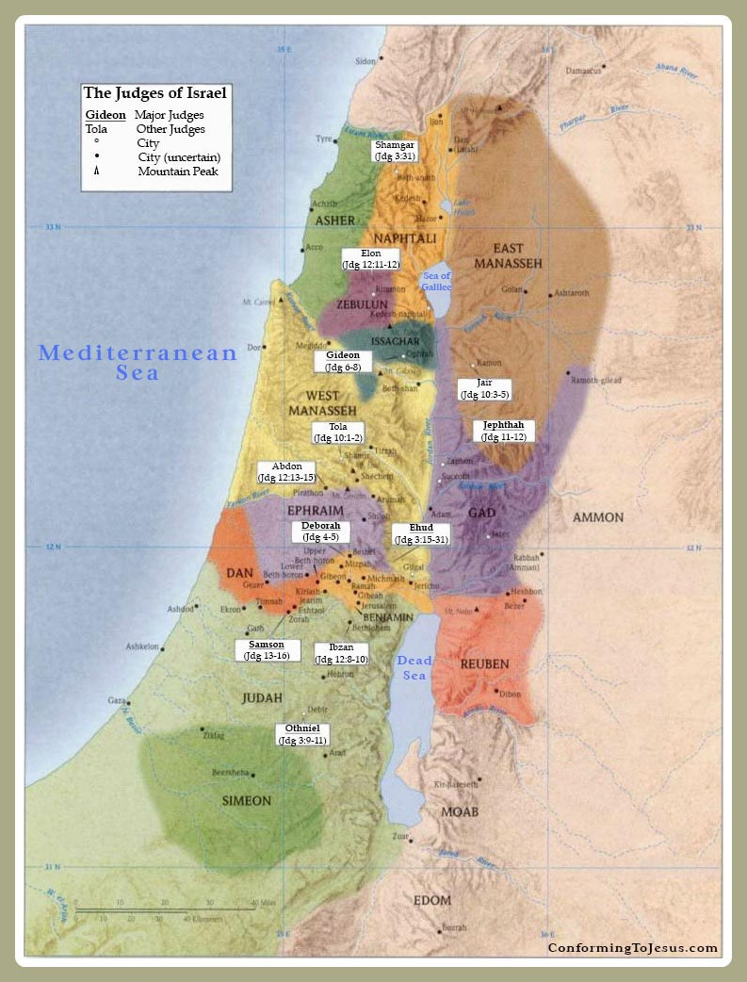

Slide 4
The Twelve Judges
Othniel Jair
Ehud Jephthah
Shamgar Ibzan
Deborah/Barak Elon
Gideon Abdon
Tola Samson

Slide 5
